Slide 1
AI-Driven Analysis of Trolley Service Gaps in Miami
MUSA 6950 Final Project | Jingqi Wang

Slide 2
Background & Motivation
Miami’s urban vibrancy relies on accessible public spaces and landmarks.
Inadequate trolley coverage may limit residents' and tourists' access.
Service gaps at key landmarks impact urban equity and livability.
This project identifies coverage gaps and prioritizes underserved neighborhoods for service improvements.

Slide 3
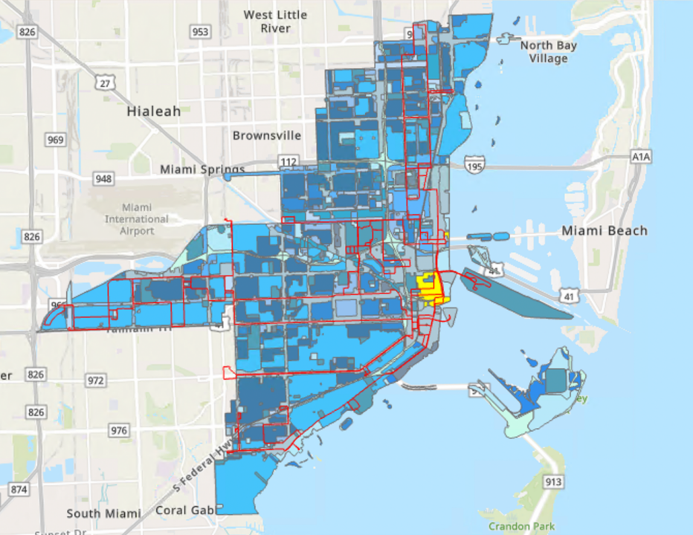
Data Sources
Miami Trolley Routes (GeoJSON)
Landmarks (GeoJSON + CSV)
Neighborhood Boundaries (GeoJSON)
Miami-Dade Census Tract Population (Shapefile)

Slide 4
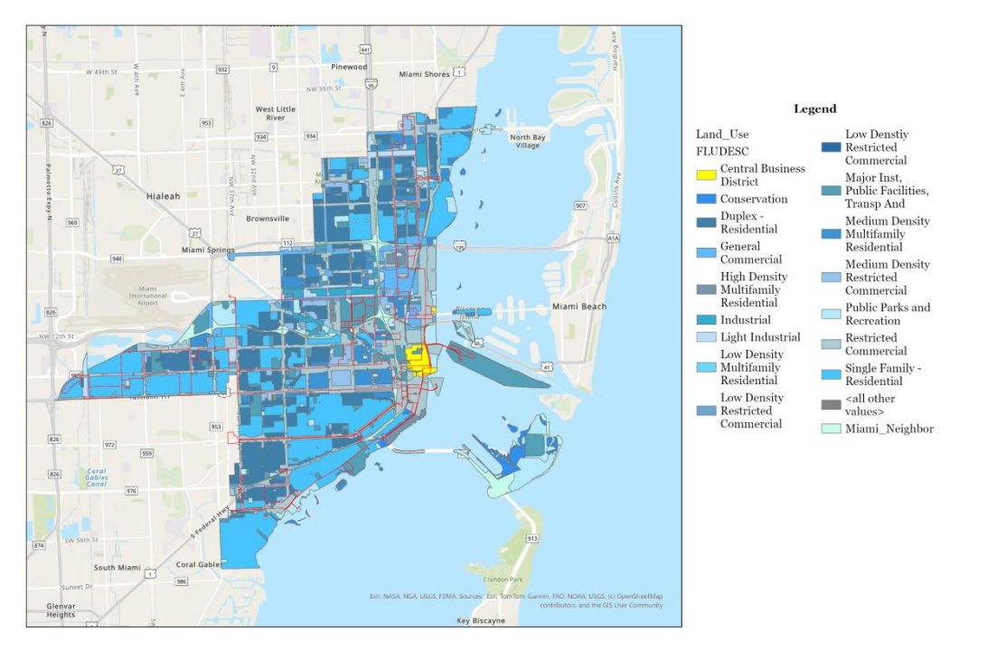

Slide 5
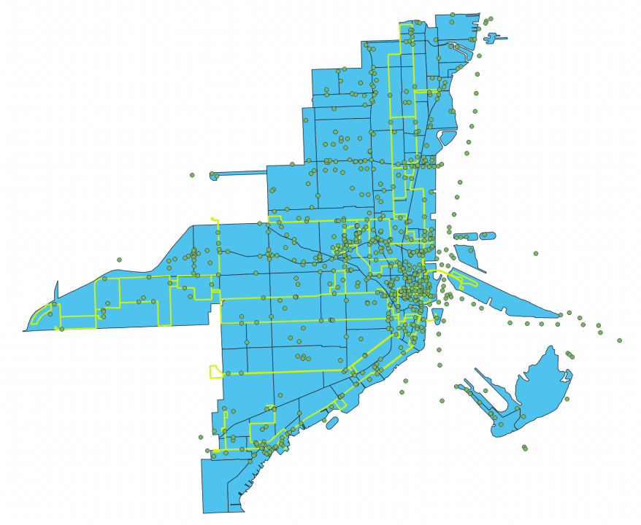

Slide 6
Overall Workflow
Accessibility Coverage Analysis
Service Gap Clustering (DBSCAN)
Neighborhood-Based Reporting
Population-weighted Prioritization
Coverage Prediction via Random Forest

Slide 7
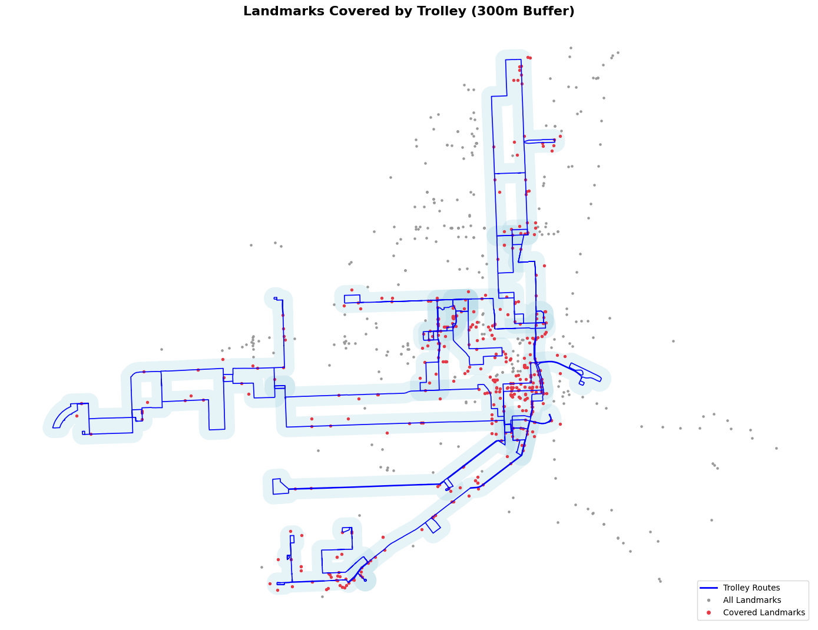
Accessibility Coverage Analysis
300m buffer created around trolley routes.
Landmarks classified as Covered or Uncovered.
Focus on critical landmarks: Parks, Tourist Attractions.

Slide 8
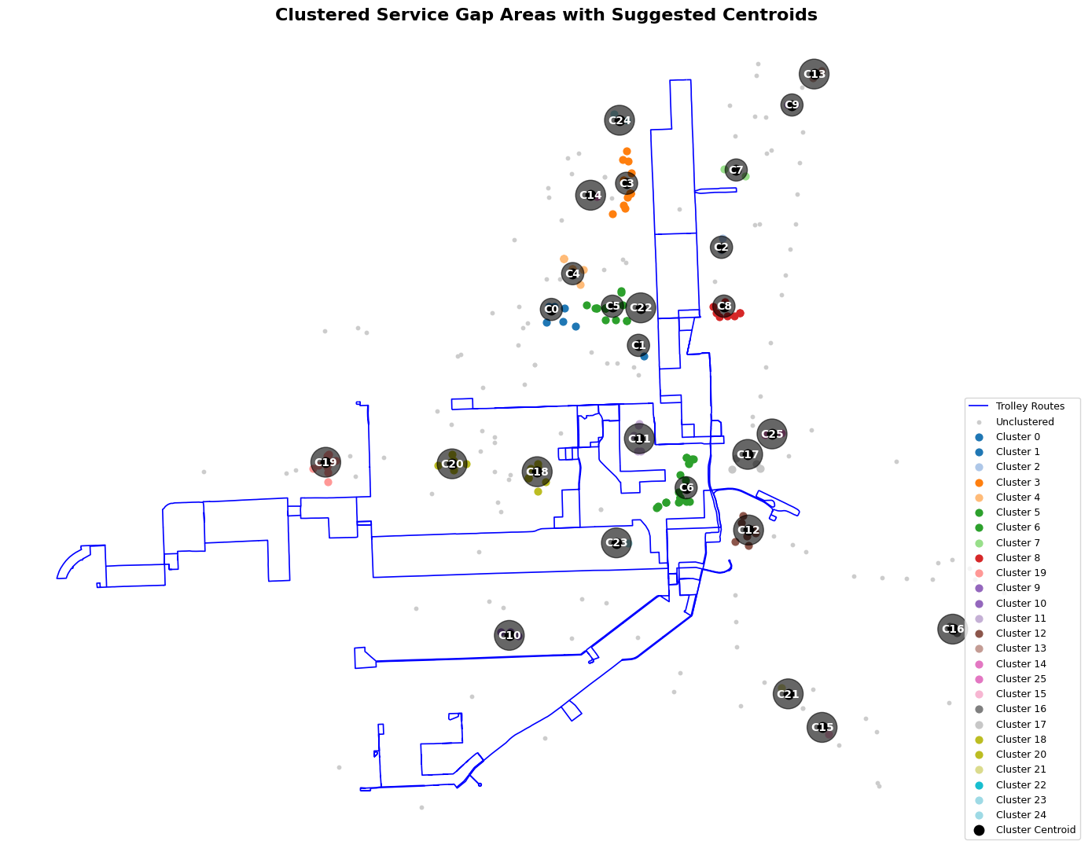
Service Gap Clustering
DBSCAN clustering applied to uncovered landmarks.
Clusters represent potential service gap hotspots.
Centroids suggested as future service hubs.

Slide 9
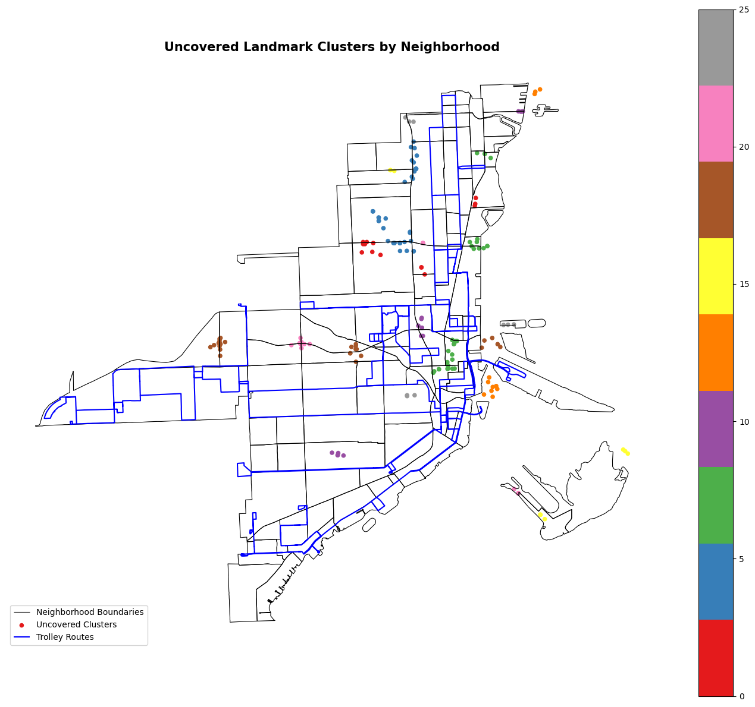
Neighborhood-Based Reporting
Spatial join with Miami neighborhoods.
Ranking based on the number of uncovered landmarks per neighborhood.
Targeted planning for service extension.

Slide 10
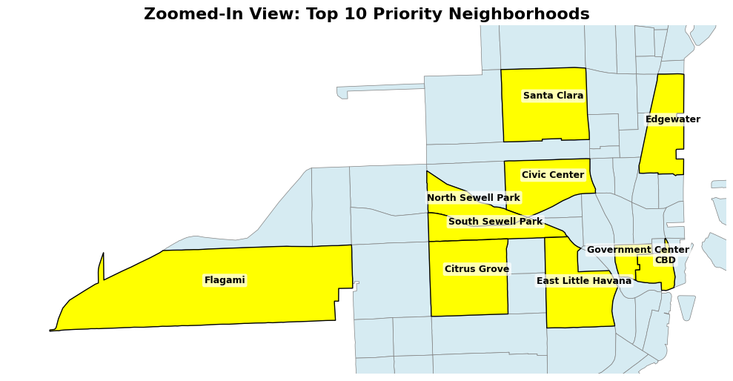
Population-Weighted Prioritization
Integrated uncovered landmarks with neighborhood population.
Developed a weighted score: Priority Score = (Uncovered Landmarks) × (Population)
Identified neighborhoods with highest service needs.

Slide 11
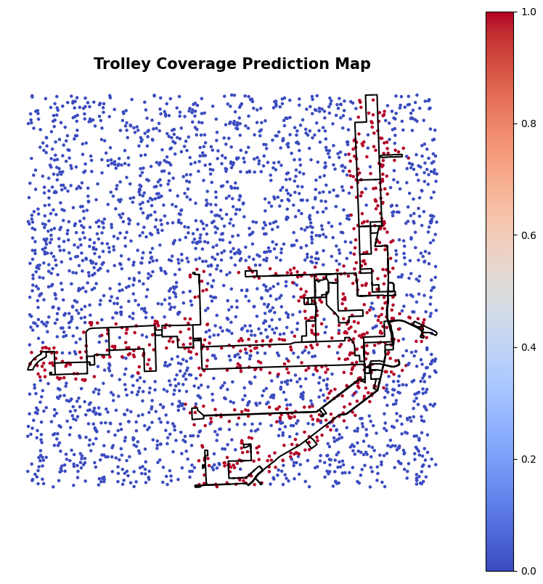
Machine Learning-Based Coverage Prediction
Randomly generated sample points across Miami
Trained a Random Forest model to predict whether a location is likely to be covered by the trolley
Features used: proximity to trolley routes, landmark density
Helped validate coverage patterns and extend inference beyond labeled landmarks

Slide 12
Key Findings
Specific clusters of service gaps identified.
Some neighborhoods consistently lack trolley access.
Population-weighted analysis reveals equity implications.
Data-driven recommendations for trolley service extension planning.
Machine learning-based prediction reinforces service gap insights, suggesting broader applicability of the method

Slide 13
Thank You!

